Slide 1
STUDENT PLACEMENT PREDICTION SYSTEM USING MACHINE LEARNING
Automating Placement Analysis with Machine Learning
Presenter: Pratik Mohite

Slide 2
Current Challenges in Placement Drives
• Manual Analysis is time-consuming
• Lack of insights
• Data management issues
• Delayed feedback for students

Slide 3
Introducing PlacementAI
• ML-powered web platform
• Instant placement prediction
• Actionable recommendations
• Admin dashboard insights

Slide 4
Smart Predictions
• Single student prediction
• Bulk CSV upload
• Intelligent recommendations

Slide 5
Administrative Dashboard
• Degree-wise analytics
• Dynamic filtering
• Smart data export

Slide 6
System Architecture
• Frontend: HTML, CSS, JS, Chart.js
• Backend: Flask
• Database: MySQL
• ML: Random Forest

Slide 7
Prediction Pipeline
Input → Feature Engineering → Prediction → Output → Dashboard

Slide 8
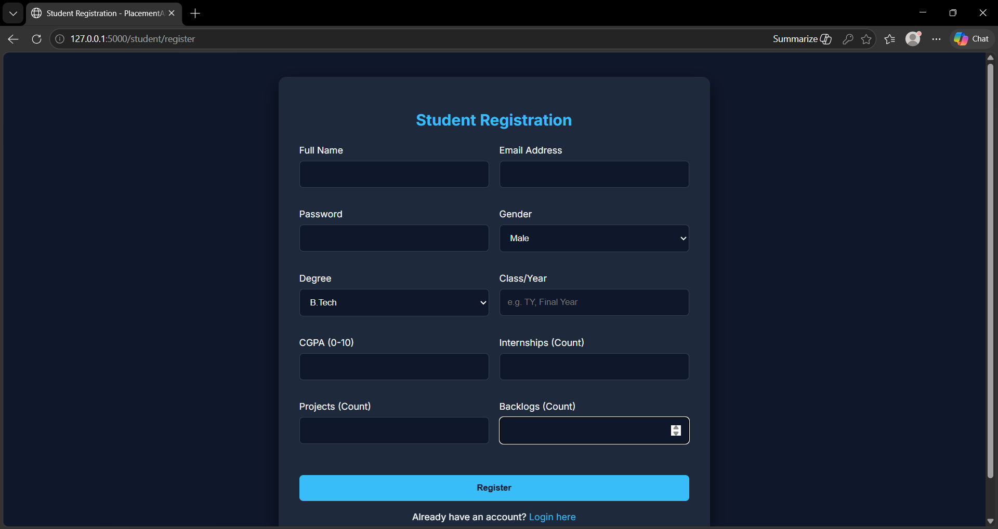
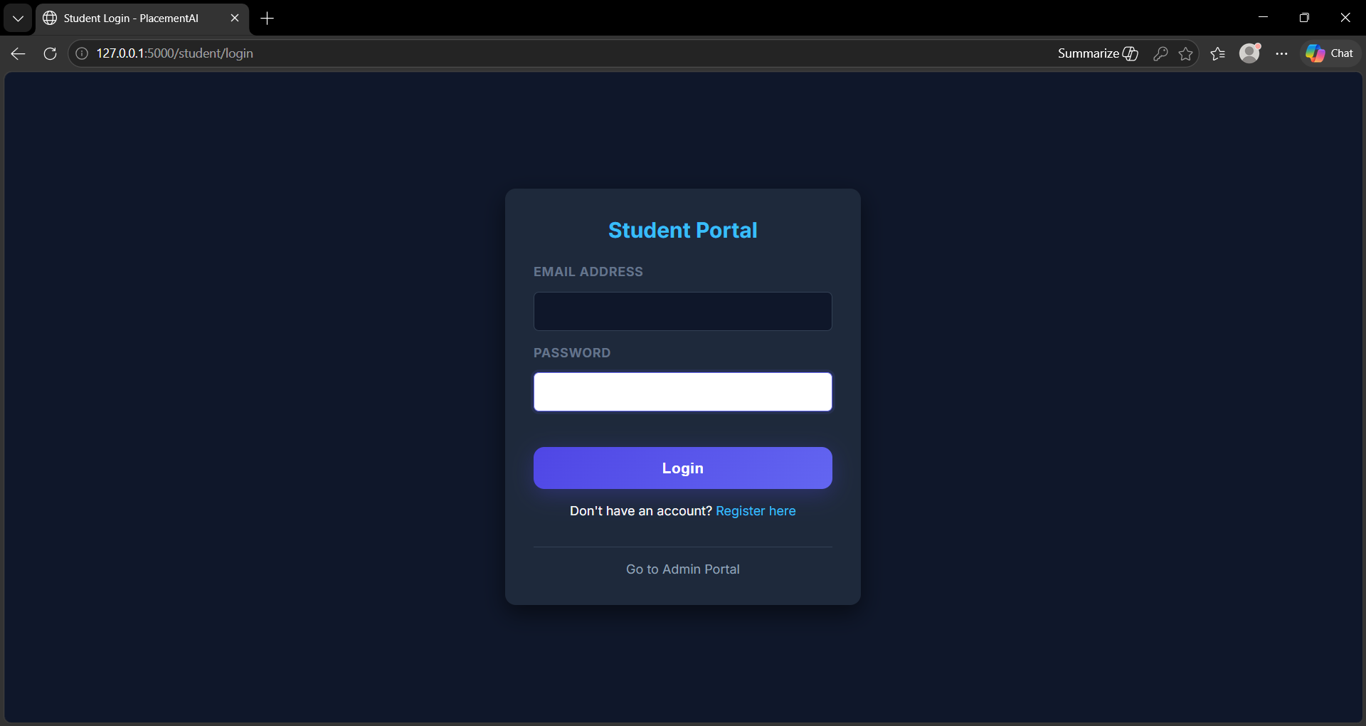
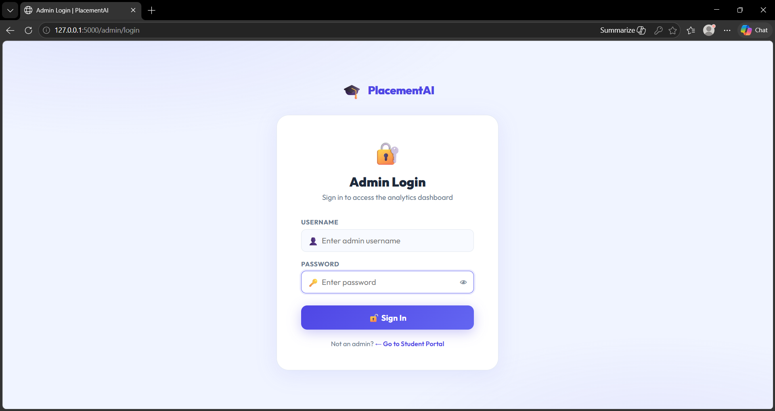

Slide 9
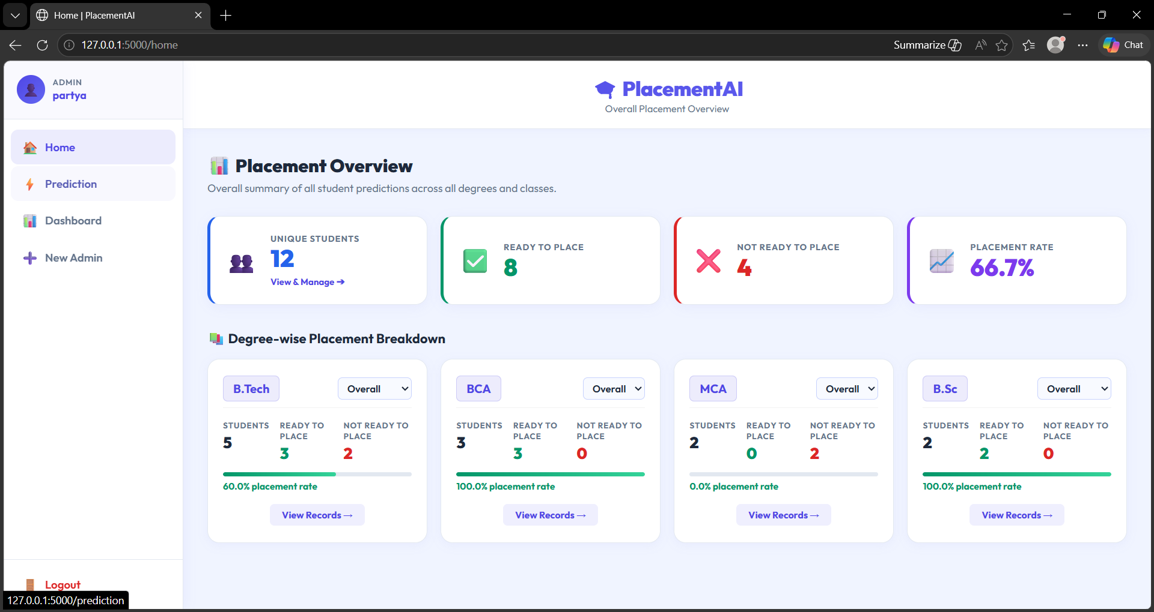

Slide 10
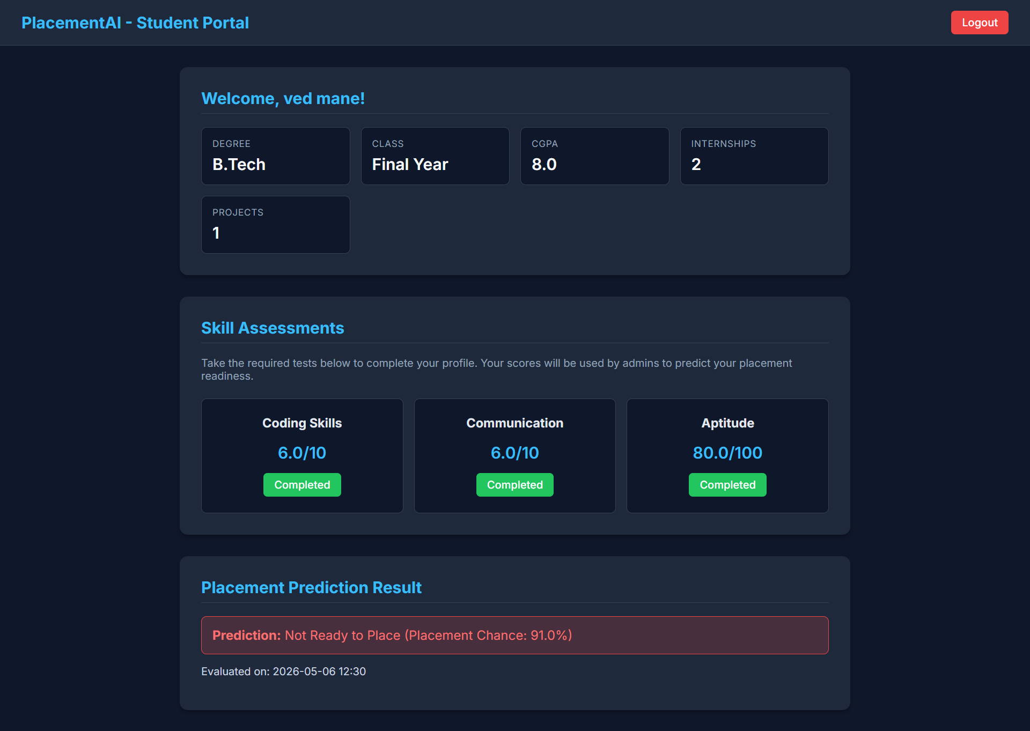

Slide 11
Future Enhancements
• Student login system
• Job role prediction
• Email integration

Slide 12
Conclusion
• Converts data into insights
• Improves placement readiness

